Slide 1
CARE Gender Marker
CARE Country Office Training 2016

Slide 2
Session Plan
This session will:
Explain the background and purpose of CARE’s Gender Marker
Introduce how to use the CARE Gender Marker
You will use the CARE Gender Marker to grade proposals
By the end of this session, participants will be able to:
Describe the purpose of CARE’s Gender Marker
Use the CARE Gender Marker to rate gender sensitivity of strategies, proposal and response

Slide 3
What is the CARE Gender Marker?
CARE’s Gender Marker assesses the level of integration of gender into our work – at all stages - including the strategy, design, and implementation
The Gender Marker is used for all of CARE’s work – development and humanitarian - and is the tool used to place programming on the strategic framework, the Gender Continuum
This helps us to learn and improve programming, and to assess how well we are matching our strategic goals
Notes:
The Gender Continuum used is from the CARE Explanatory Note on CARE’s Gender Focus. https://www.care.at/images/_care_2013/expert/pdf/COE_Resources/Gender/Explanatory_Note_on_CAREs_Gender_Focus_2012.pdf

Slide 4
Background to CARE's Gender Marker
Original CARE Gender Marker was developed to assess the whole project cycle for humanitarian response
The tool was piloted in the Syria region, West Africa, and Philippines, and reviewed from 2013-2015
External review recommended institutionalisation into CARE’s systems and expansion to cover development
Notes:
Developed to complement and build of the Inter Agency Standing Committee Gender Marker that only graded the proposal stage. Impetus for CARE, with a dedicated gender focus, to engage with the realities of their programming throughout the whole program cycle. Further impetus by the low gender marker scores being received relative to our peers. This original tool was piloted and reviewed. The new Gender Marker is based on the recommendations of the review.

Slide 5
The CARE Gender Marker Revisited…
CARE’s Gender Marker was developed through a large consultation process which involved members and profiles from all over CARE;
CARE’s Gender Marker is to monitor integration of gender in our work;
This is complementary to M&E systems, which monitor outcomes;
The Gender Marker is used for all of CARE’s work – both humanitarian and development;
The grades from 0-4 fit directly onto CARE’s Gender Continuum, helping us to link our work with our Programme Strategy.

Slide 6
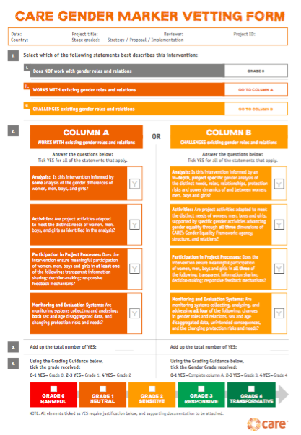
CARE Gender Marker Tools
Notes:
Talk through the steps on the Gender Marker – introducing each of the steps, and the points within them – invite participants to look at their document pack whilst you are discussing each relevant point. The Gender Marker Vetting Form is a step-by-step flow chart that identifies where projects are graded (0-4) along the Gender Continuum. The current Gender Marker Guidance Form is for Country Offices. More Guidance for CMPs will be available soon.

Slide 7
Let’s try it out!
Read the project design summary
Review the Gender Marker Guidance
Use the Gender Marker vetting form to code the project design
Include comments about what modifications could be made to the project to improve gender integration

Slide 8
How does this tool fit with other Gender Markers?
CARE’s Gender Marker is different but complementary to the IASC and ECHO Gender Markers
CARE’s Gender Marker is the only marker used in both development and humanitarian
The grading differs – CARE’s Marker grades above 2, allowing greater detail beyond gender sensitive
Scoring 2 or above on the CARE Marker should equal 2 on IASC/ ECHO
Notes:
You may have to use all three if required, but each will provide you specific indications and lessons you can build from

Slide 9
Wrap-up
The Gender Marker helps us to assess gender integration, and whether we are meeting our gender commitments
The Gender Marker is easy to use, and can help us to improve our programming – learning is key!
The Gender Marker is in the PIIRS system, but can be used in many different ways to improve our programming – any ideas?
Questions?

Slide 10
More information?
Isadora.quay@care.org.au

